Slide 1
ASSIGNMENT 1
Submitted by,
Ananya b
Mca-s1

Slide 2
objectives
Task
Introduction
Things learned from centralized vs
Basic workflow of centralized vc
Installation of client and server
Initial configurations
Operations in centralized vs
Commands in svn
Git vs svn
Git vs svn commands
Conclusion
references

Slide 3
TASK
Install and try to work with any free centralised version control system. Explore how software project version are tracked by the system. Try to understand how it is different from a distributed version control system(like GIT).

Slide 4
INTRODUCTION
In this presentation, I am explaining that what was I studied about the centralised version control system and what are the things I do for installing a centralised version control system and what was I learned from it to use it and what are the differences I noticed from centralised version control like VSN(visual svn server )and Tortoise svn client when compared to distributed version control system like GIT that have I used.Here I am explaining that I have installed Visual SVN server and tortoise client.Also I studied what are the commands used for performing different operations in this centralized version control system.

Slide 5
Major things I learned about centralised version control system
First I learned that Centralised version control system is a server –client model so the server maintains all versions of code.
Therefore if I am member of a project group and I want to add any new feature to the code,firstly i need to get the full code from the server.
Then i want to do any changes in the code, I want a copy of the whole version of the code in my local machine.
So once I get the copy of code, then I can do my changes to it and after that i need to commit those changes straight forward into the server.
Hereby I learned that in this model everything is centralized and this contains a single master repository ,it stores all the versions of the code and it contains several branches of code.

Slide 6
Basic workflow of cvs that I learned
The workflow involves in the centralized source control is getting the latest version of the code from a central repository or server that will contain other group member’s code also, making our own changes in the code and then committing or merging those changes into the central repository or server.

Slide 7
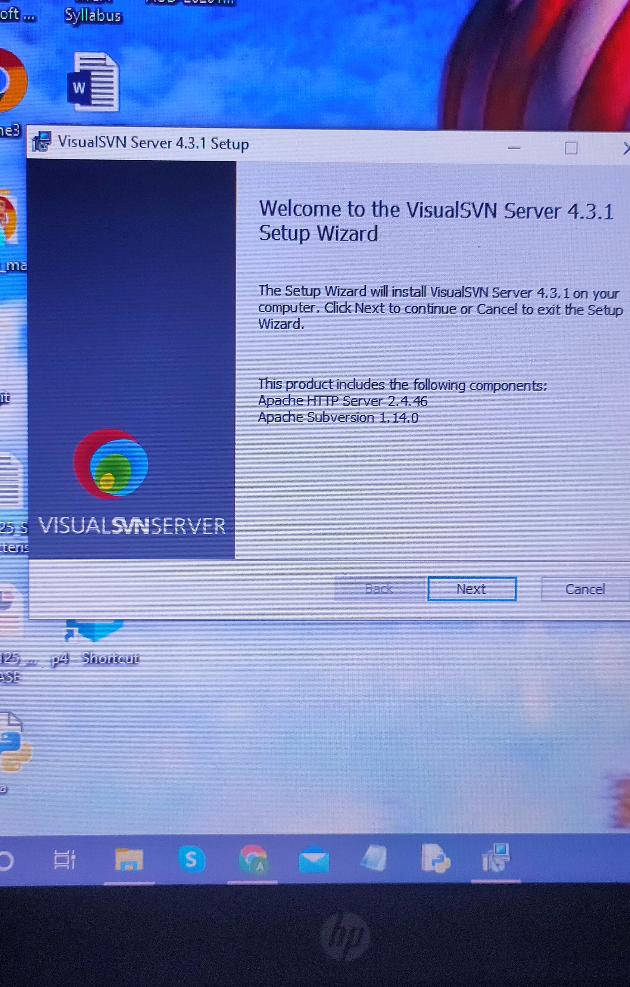
Installation of visual svn server and tortoise svn client
I installed the visual svn server from the website “www.Visualsvn.Com”

Slide 8
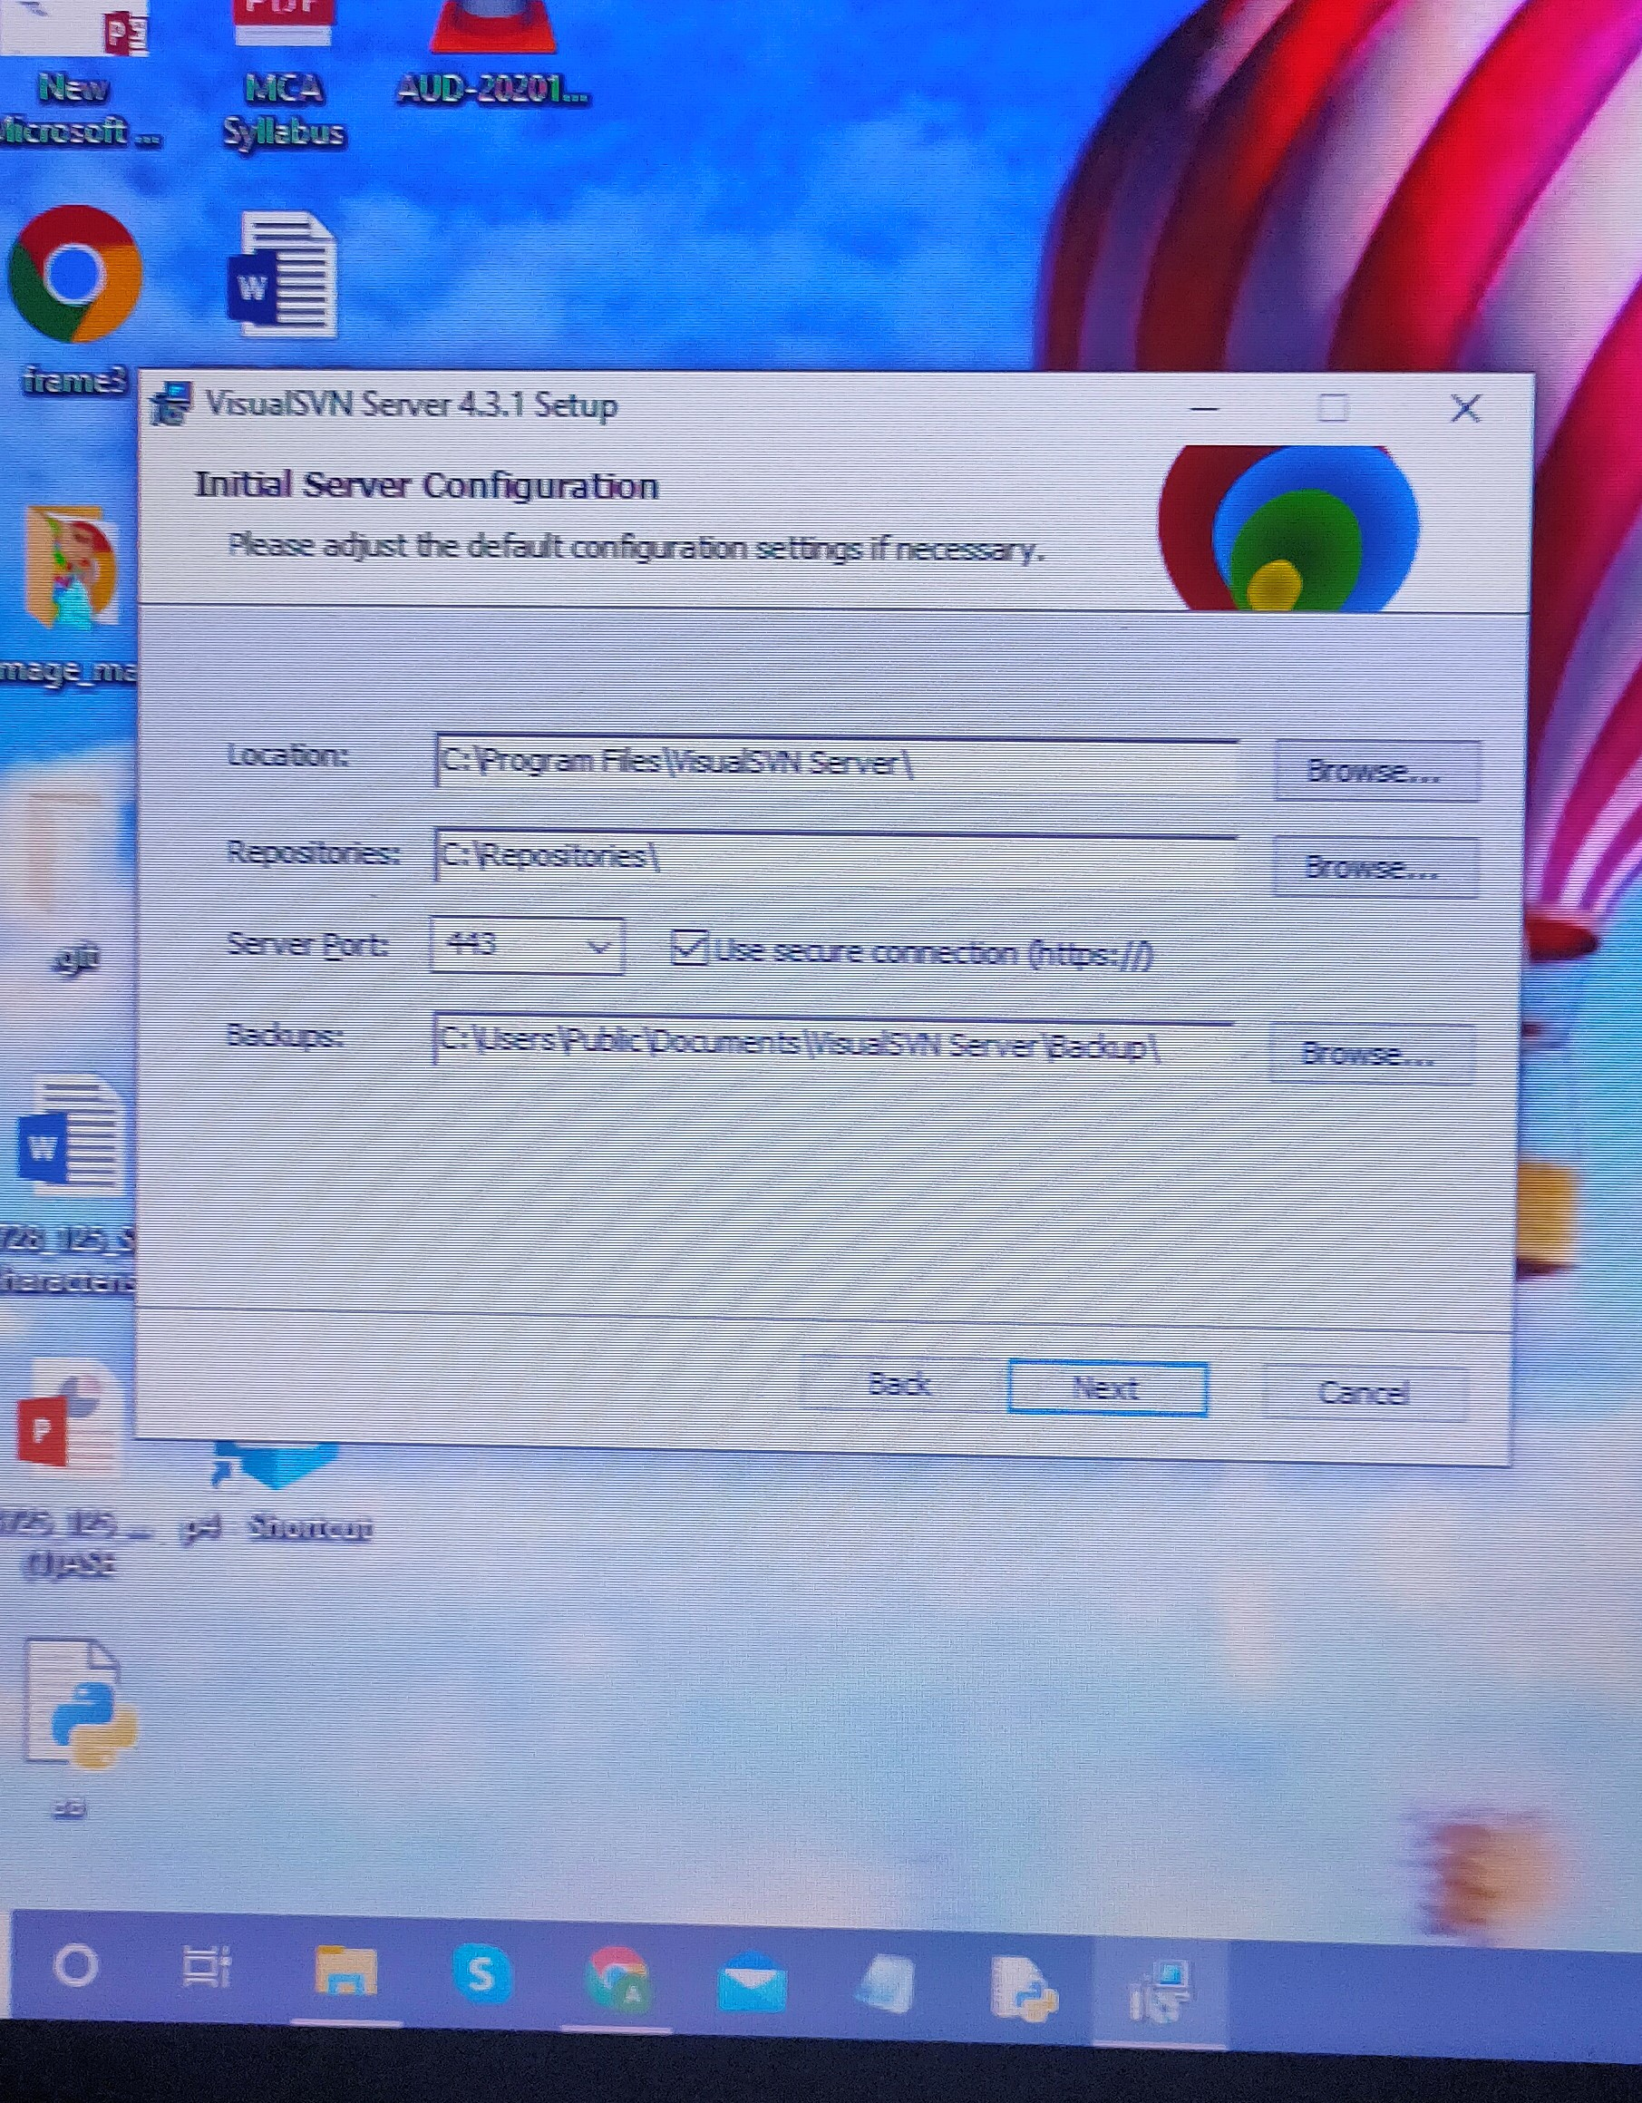
initial Configuration of the server
I initially configured the location, repositories and server port of the server

Slide 9
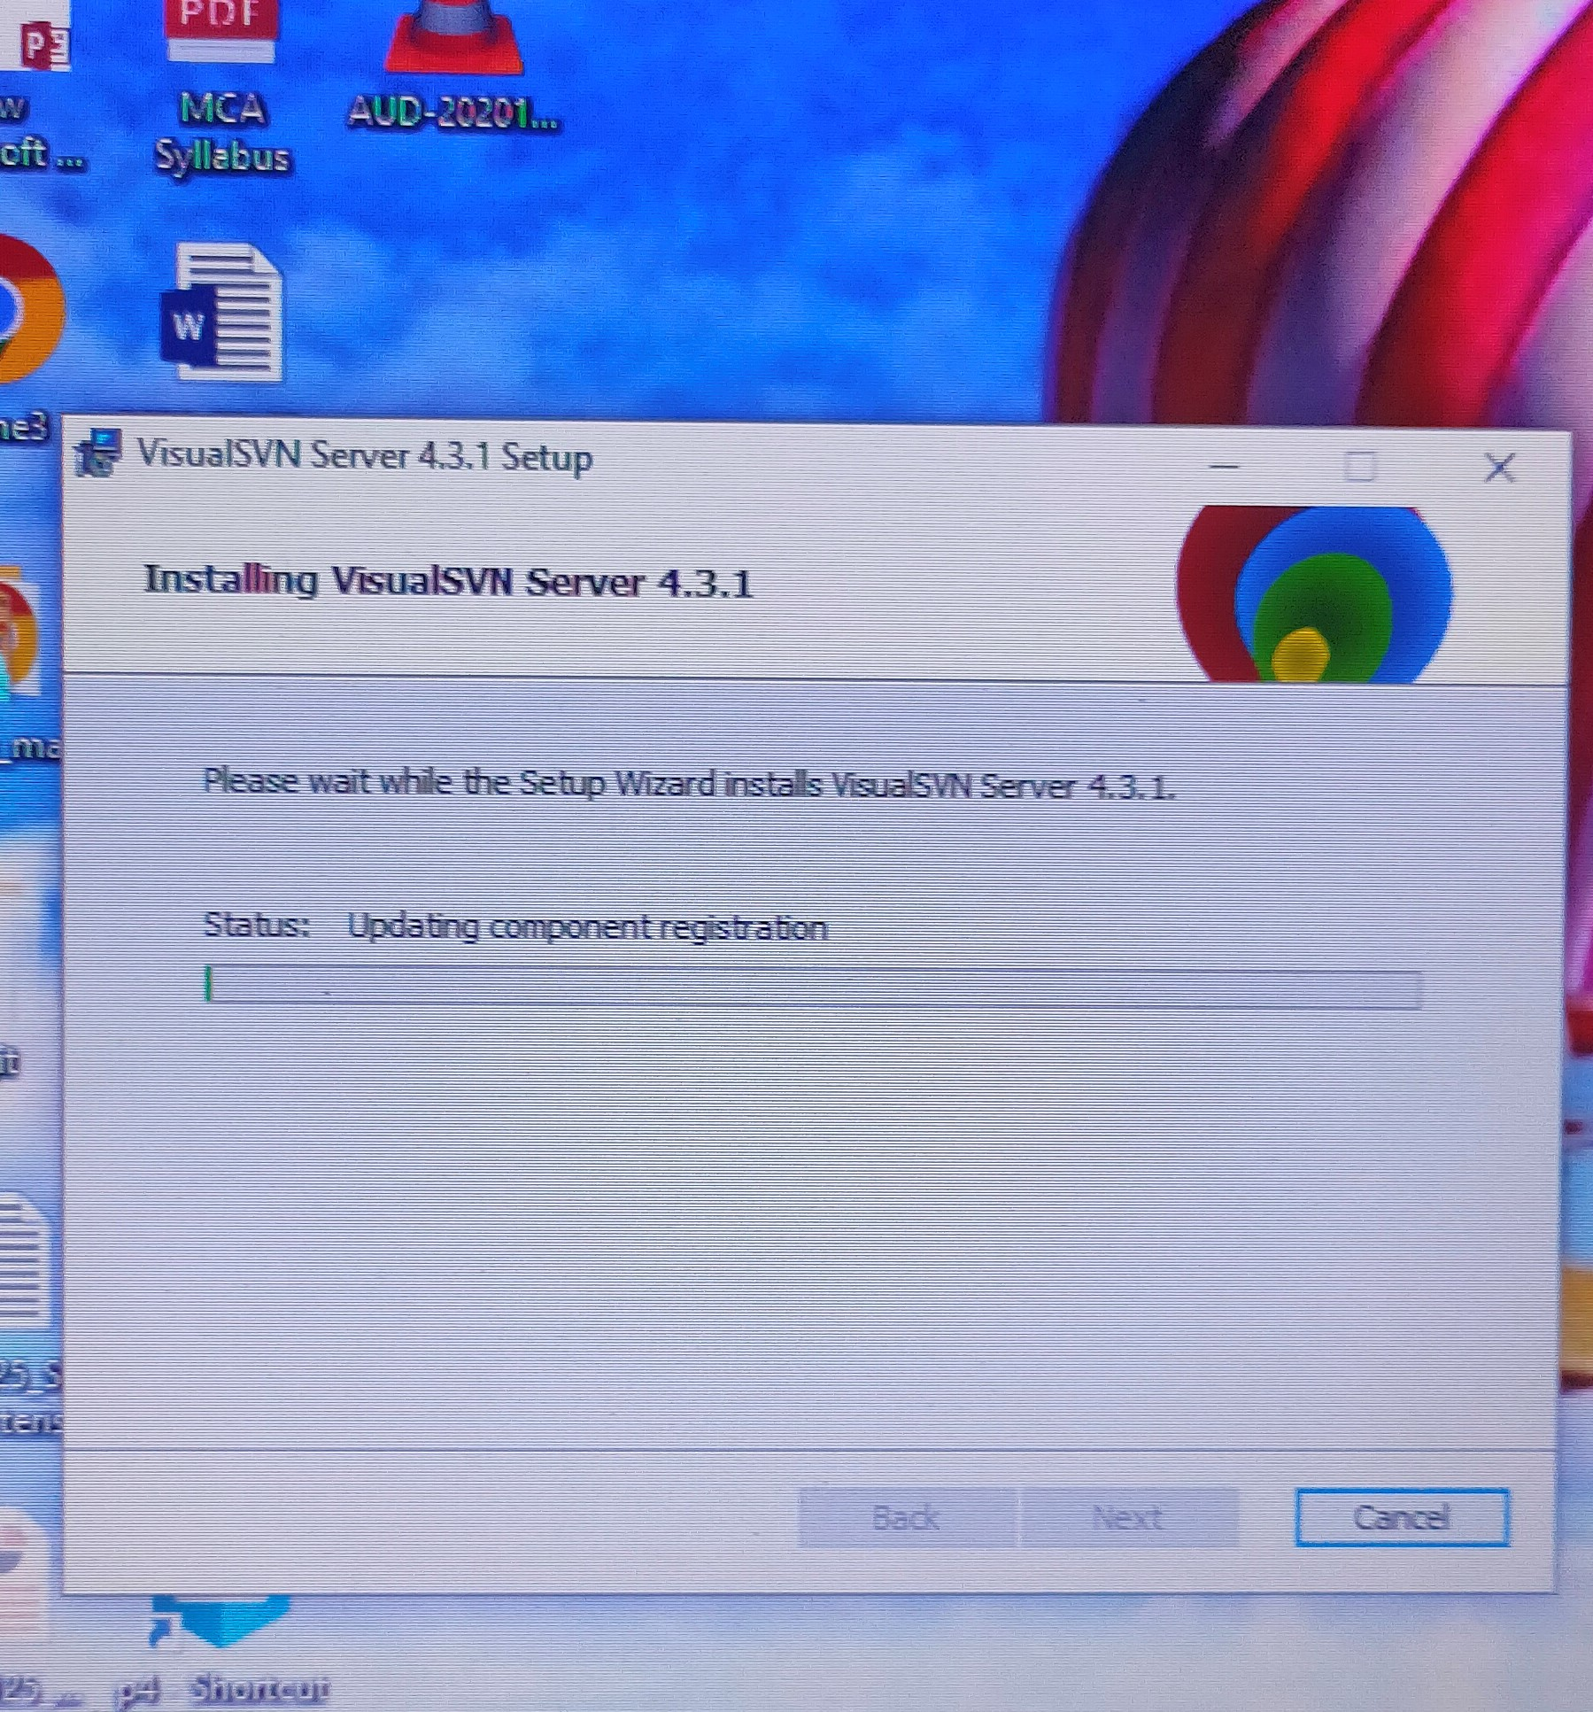
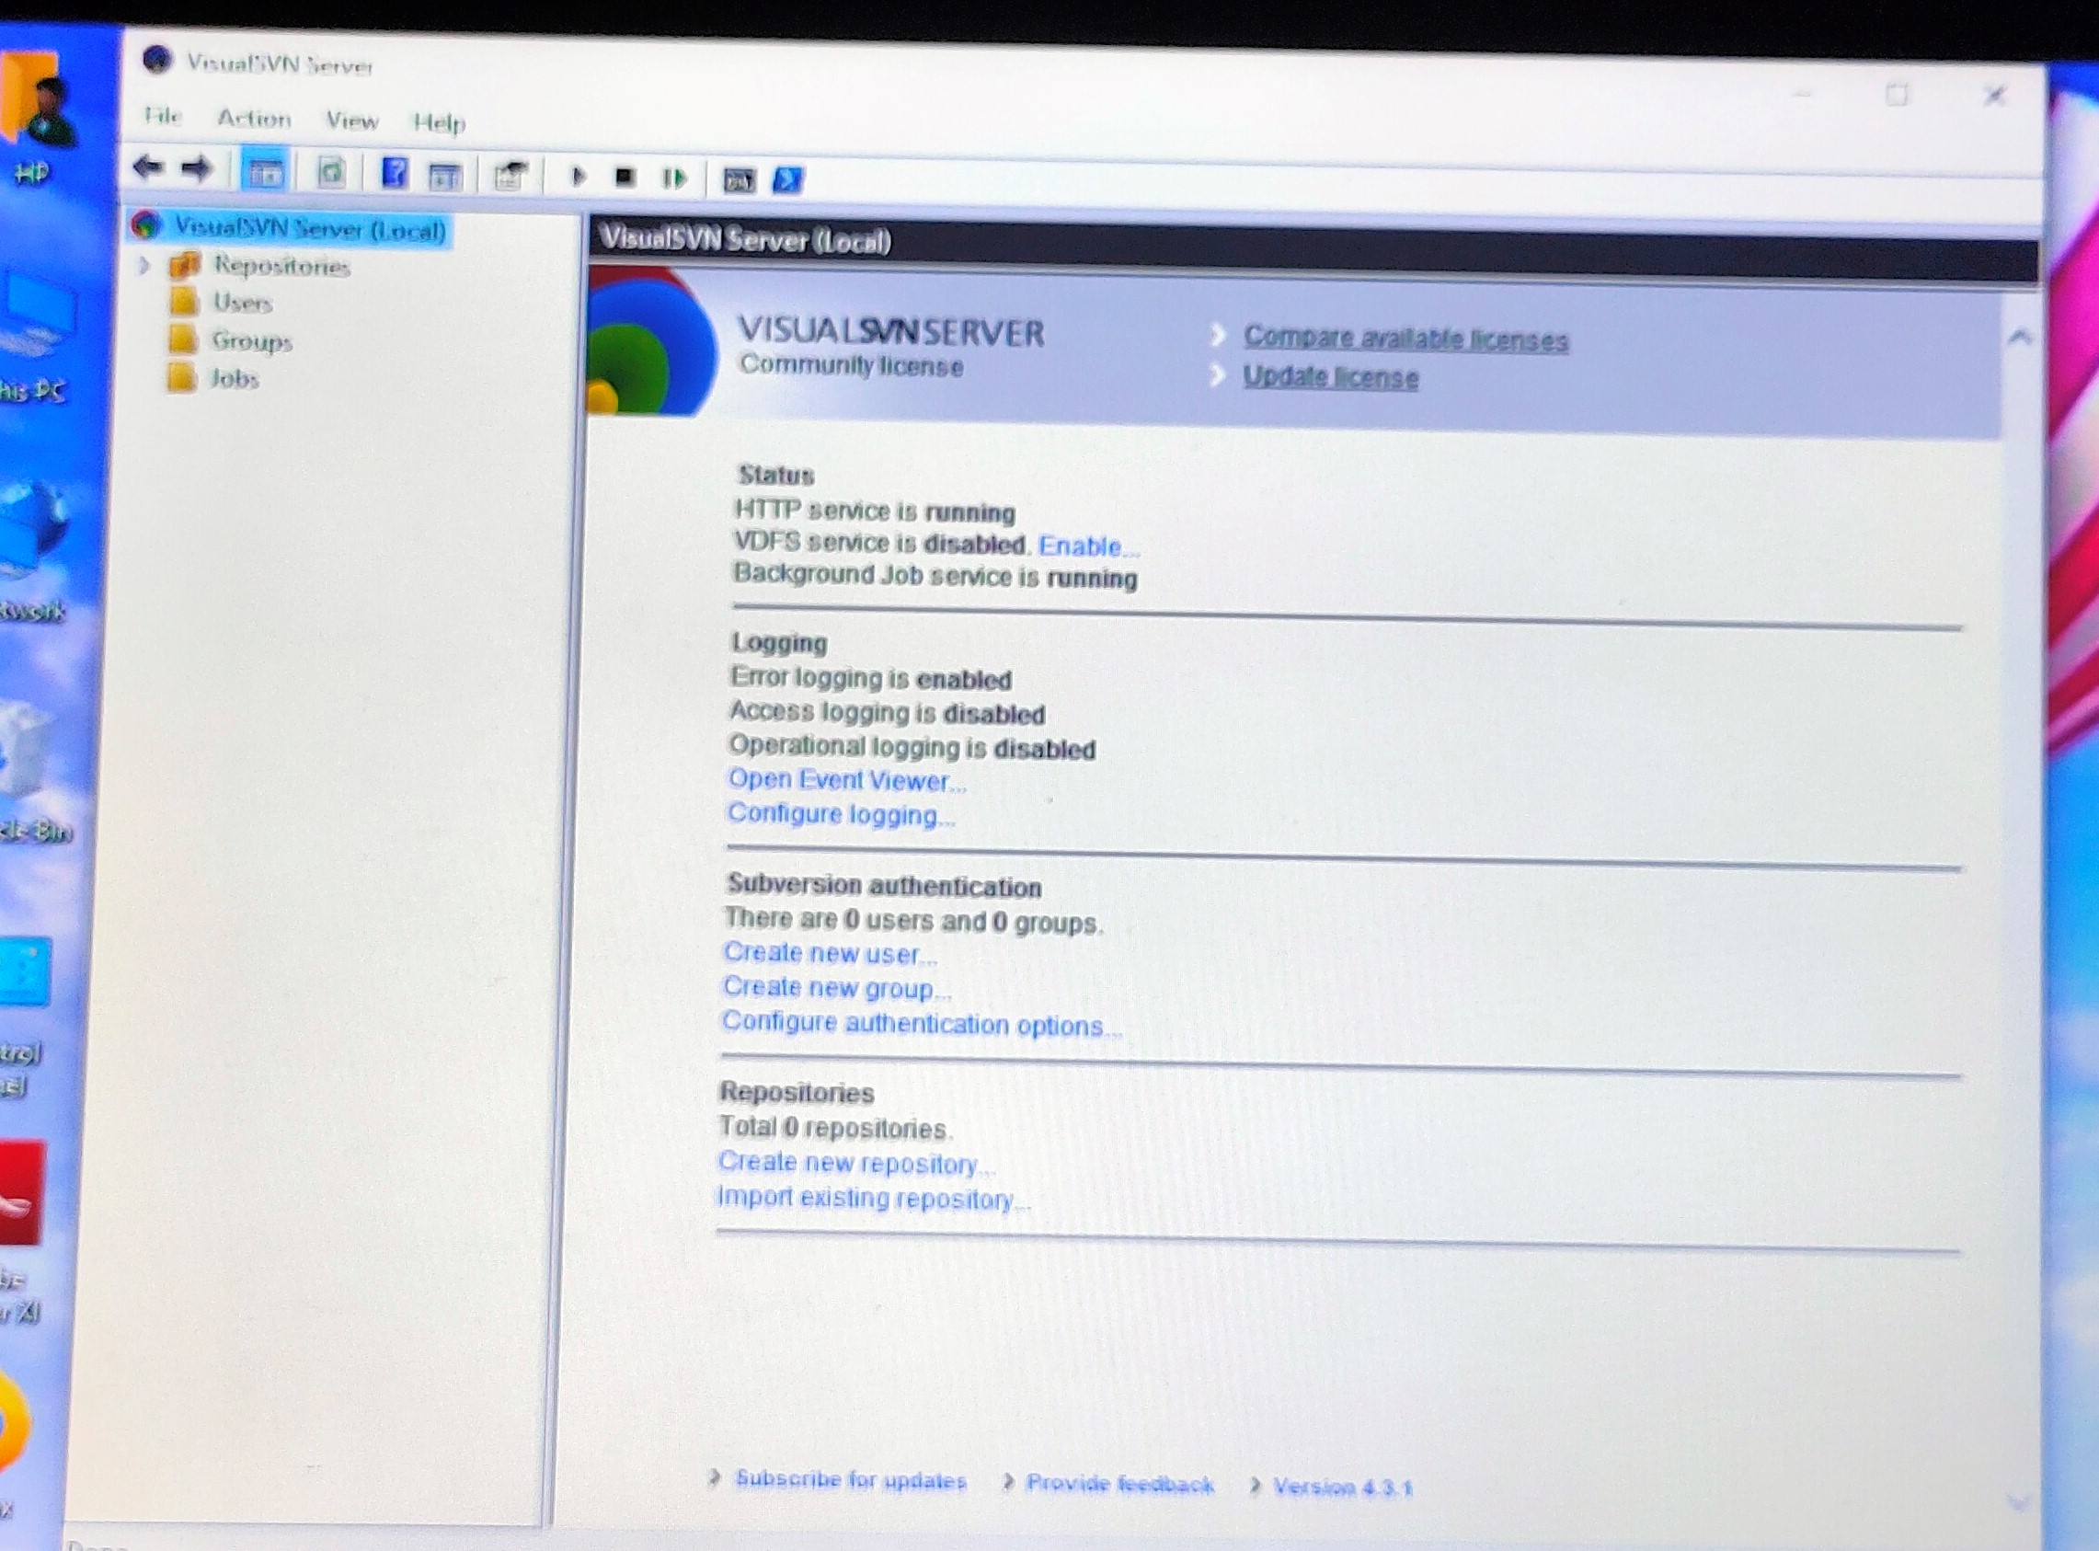
After all configurations vsvn gets installed and visualsvn server manager will launch as soon as the installation is completed

Slide 10
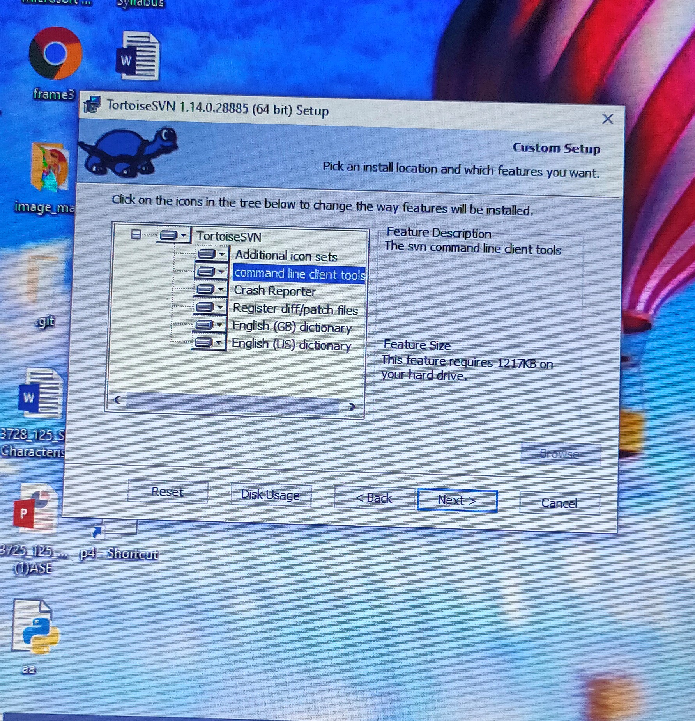
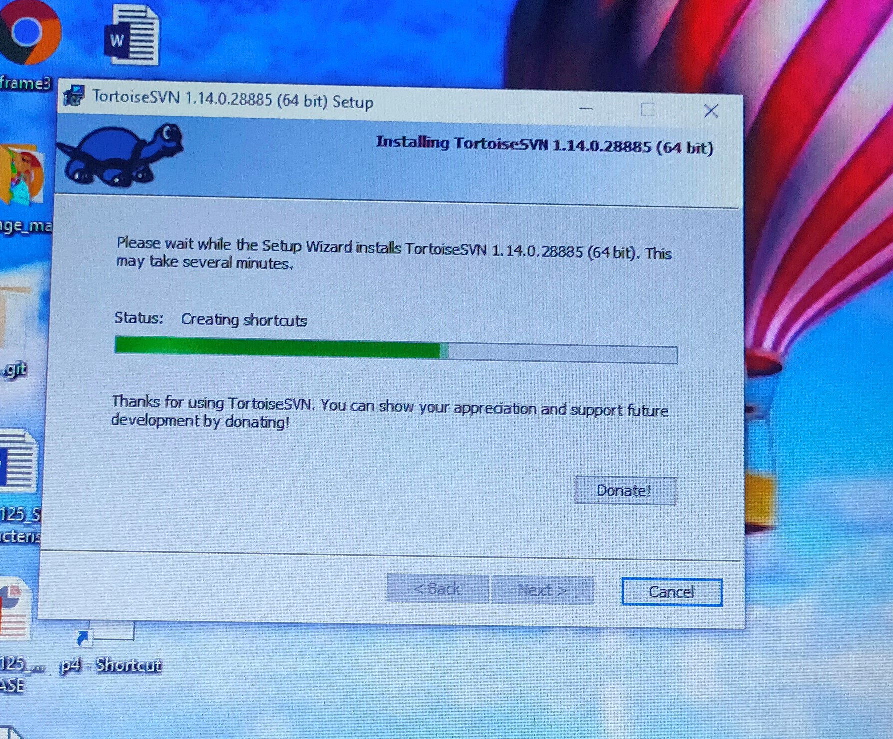
After installing the server, we have to install a client ie; tortoise svn client
And in client’s configuration i installed the feature like svn command line tool to communicate with svn server through command line.

Slide 11
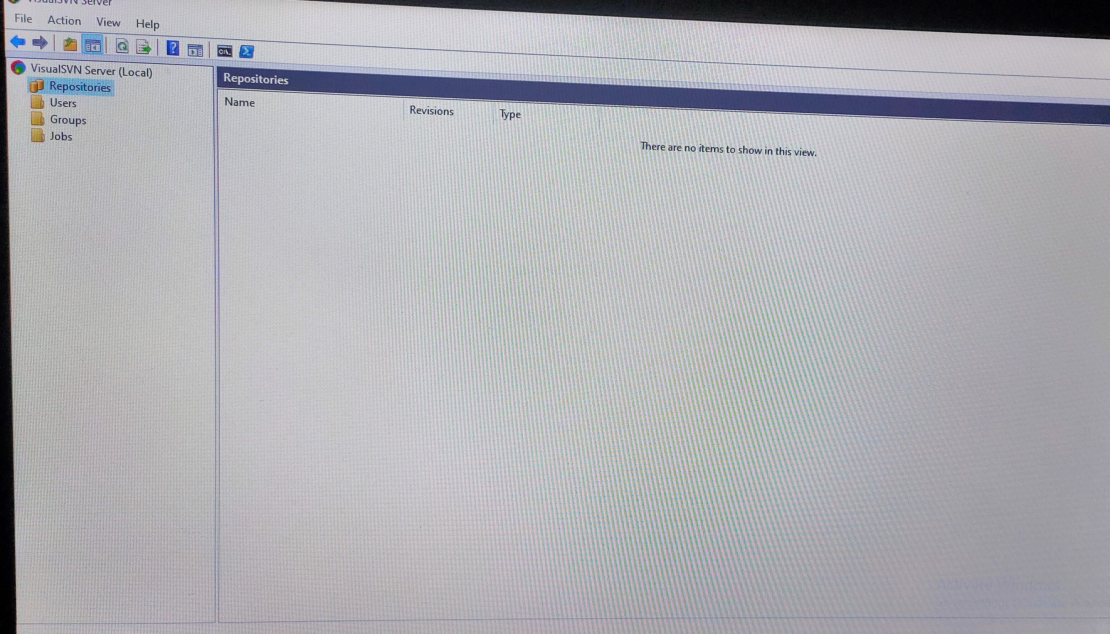
Operations in cvs
Initially the visual svn server manager is like this

Slide 12
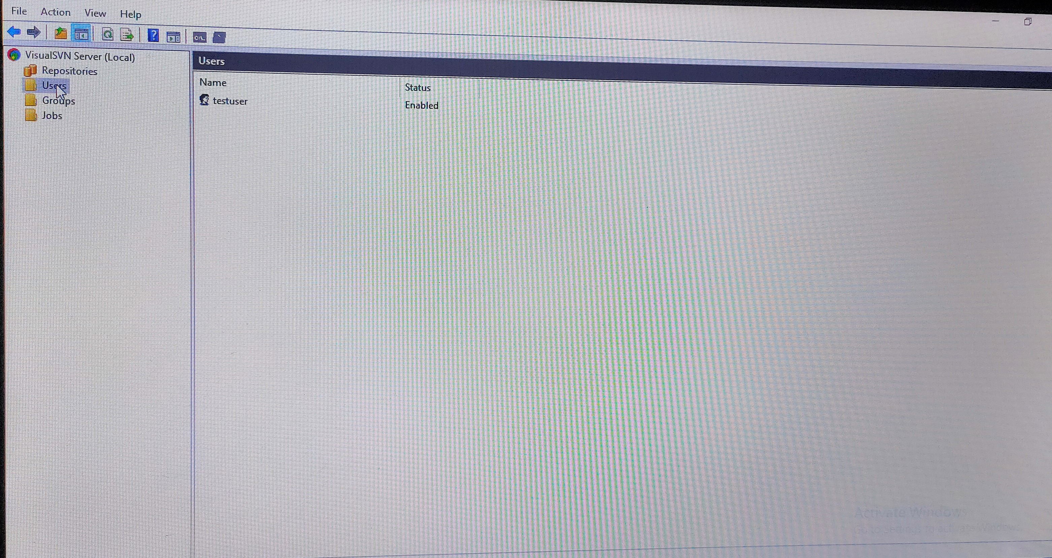
Next step is to add the user and setting username and password for authentication here ie,testuser

Slide 13
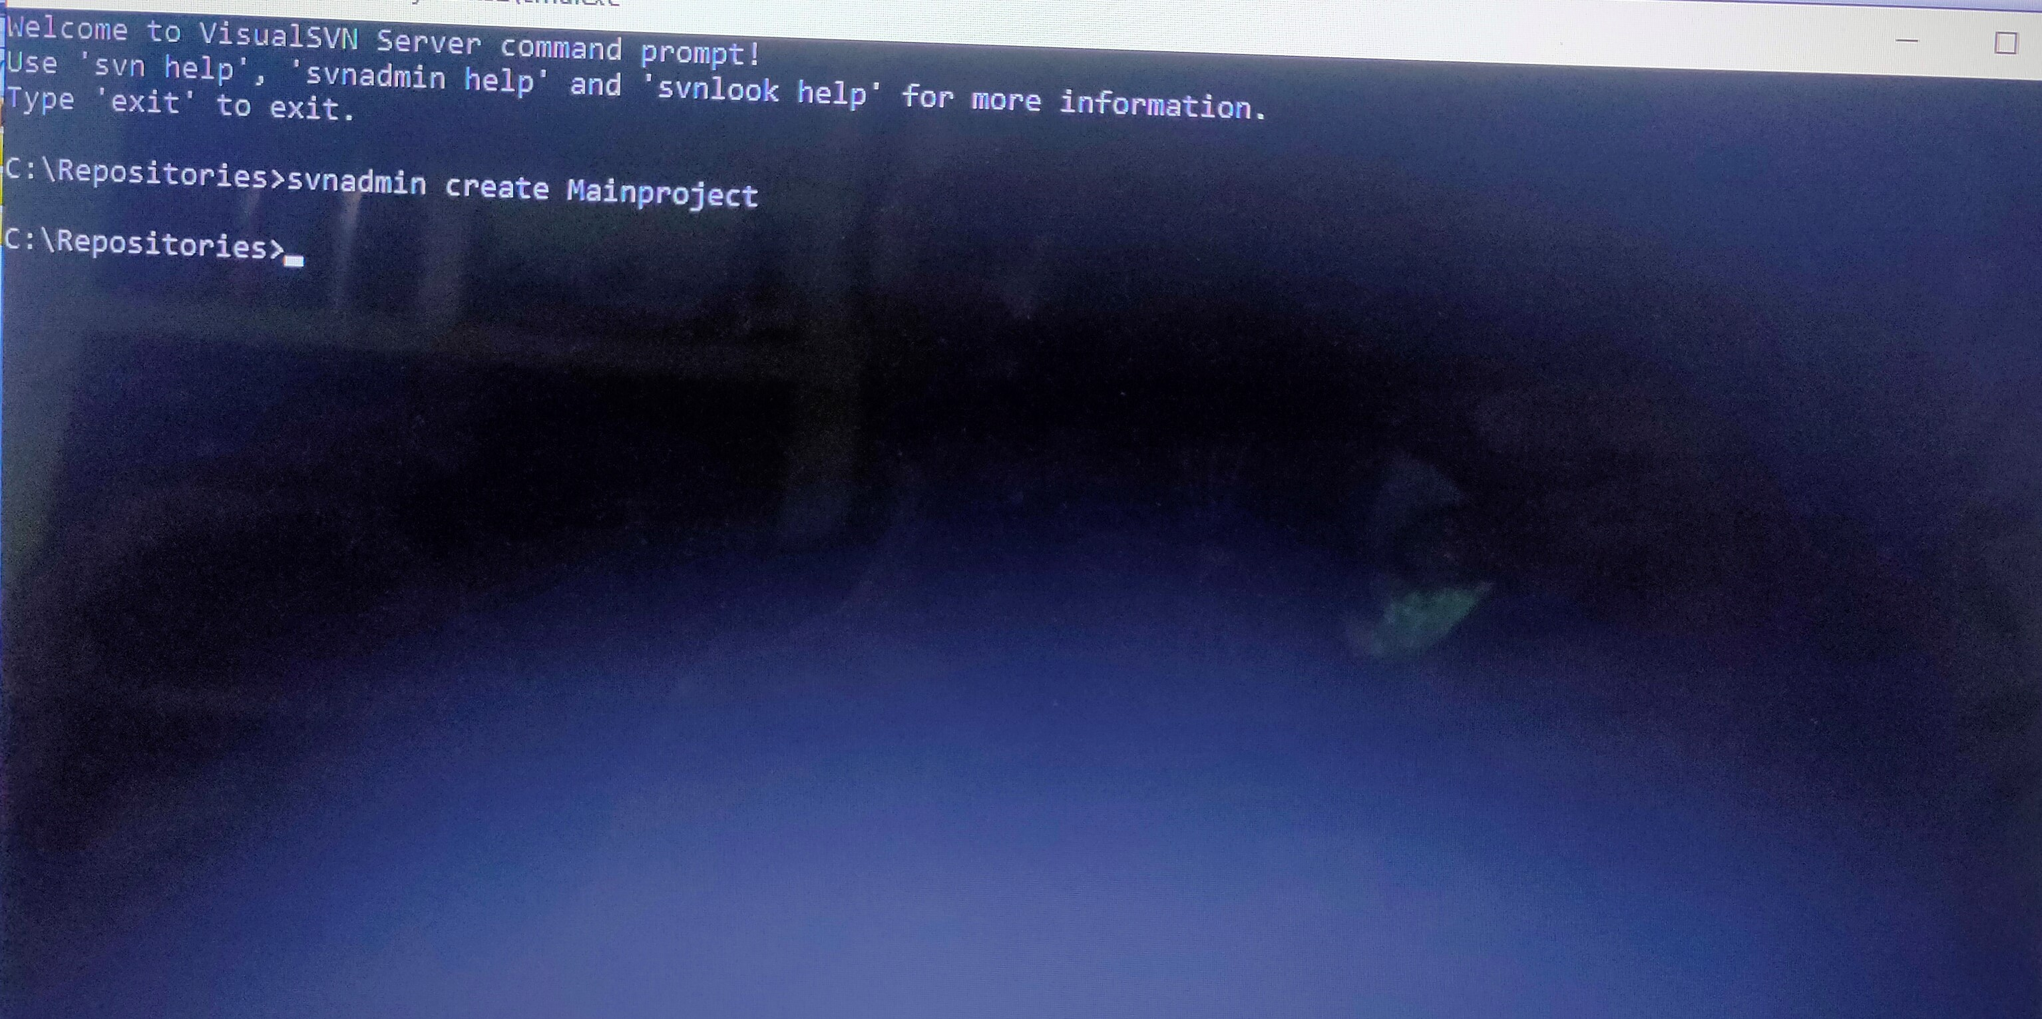
svnadmin create command: In svn the svnadmin create command creates a new, empty repository. For example I tried to create an empty repository like “Mainproject”

Slide 14
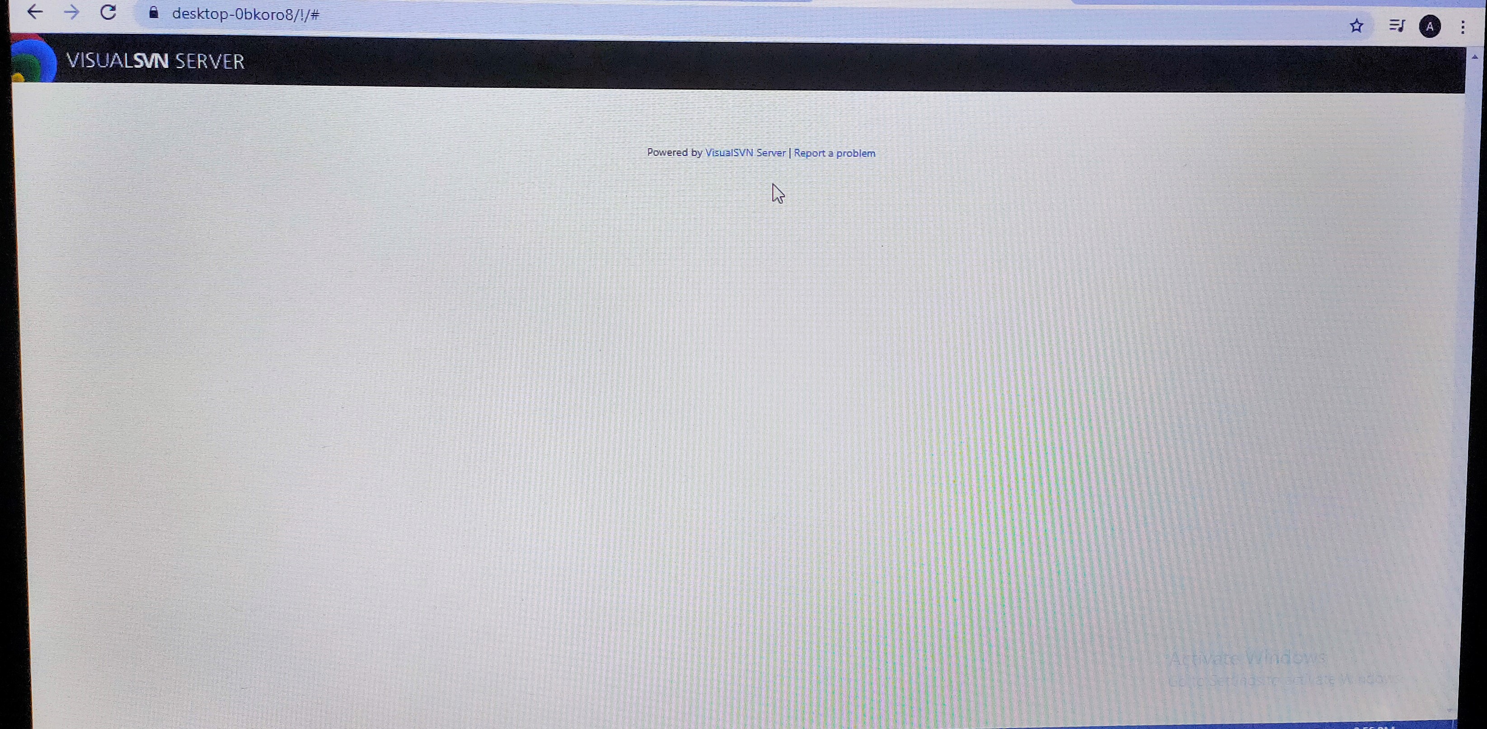
Then I copied the url of the repository in brower and browse it,it looks like this that time ie;blank page or empty.

Slide 15
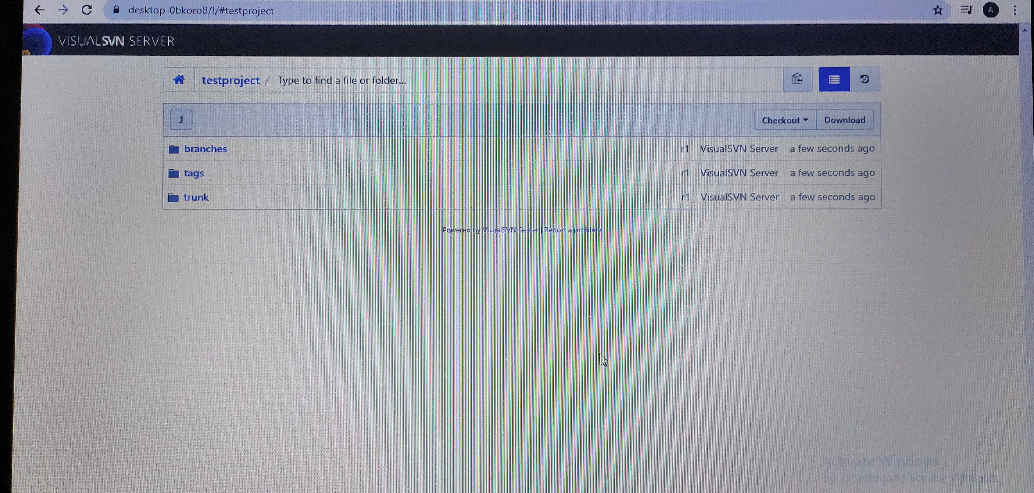
Then I created another repo called testproject having subfolders like trunk,branches and tags.Then I copied the url and checked ,and I can see the changes like this..

Slide 16
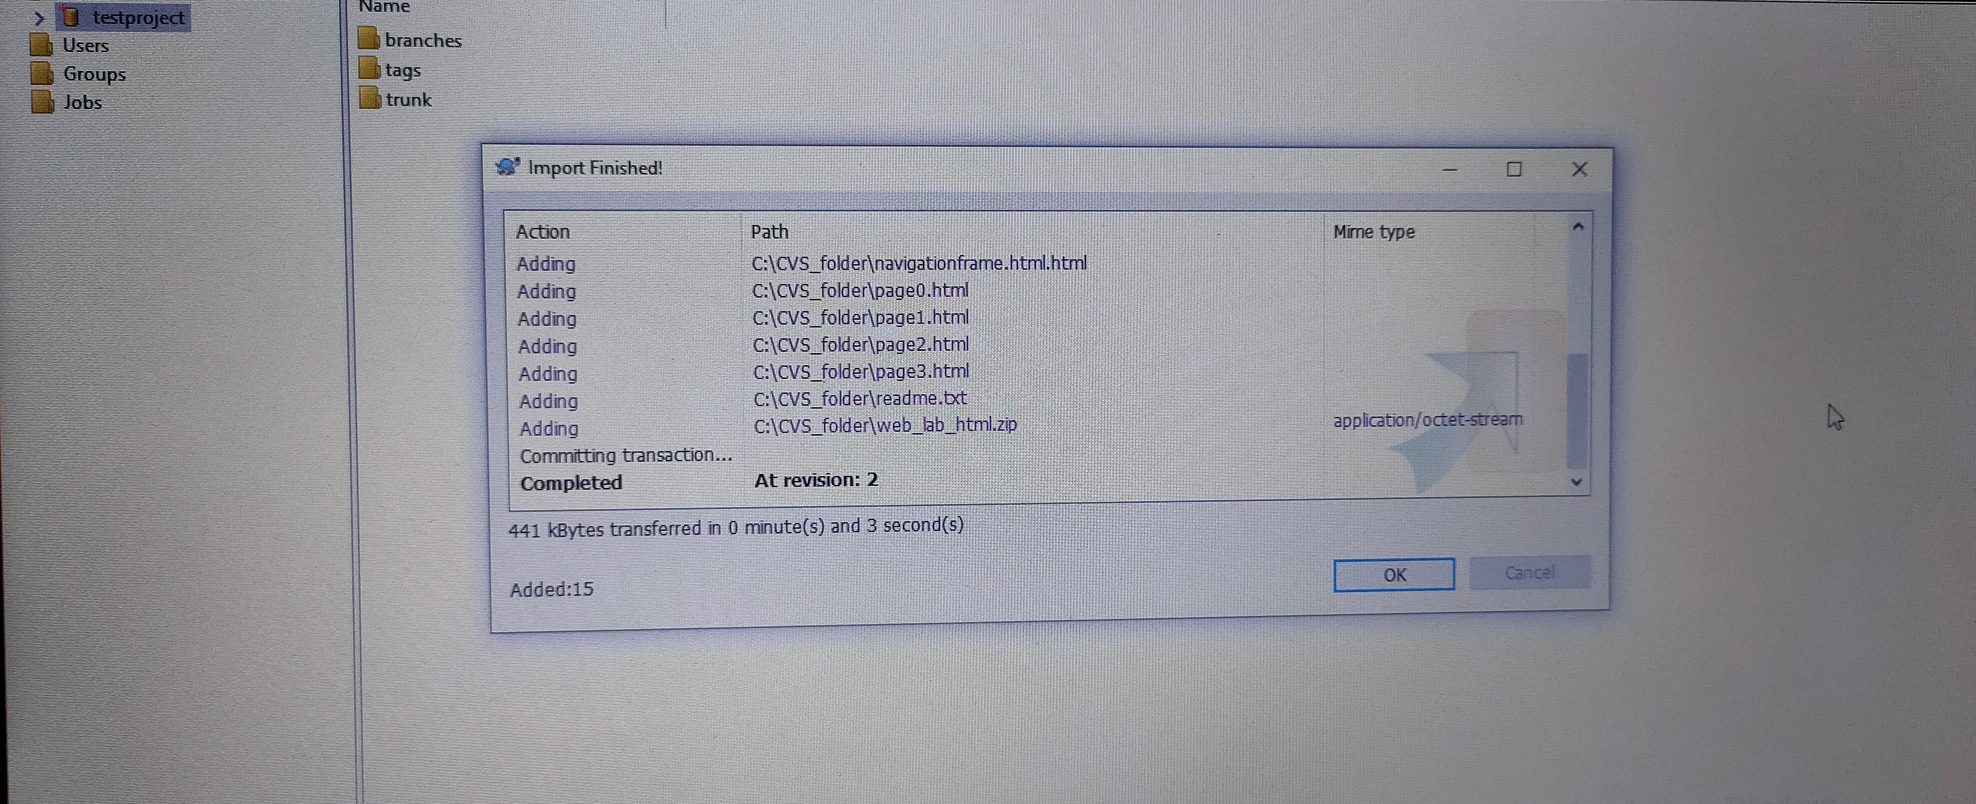
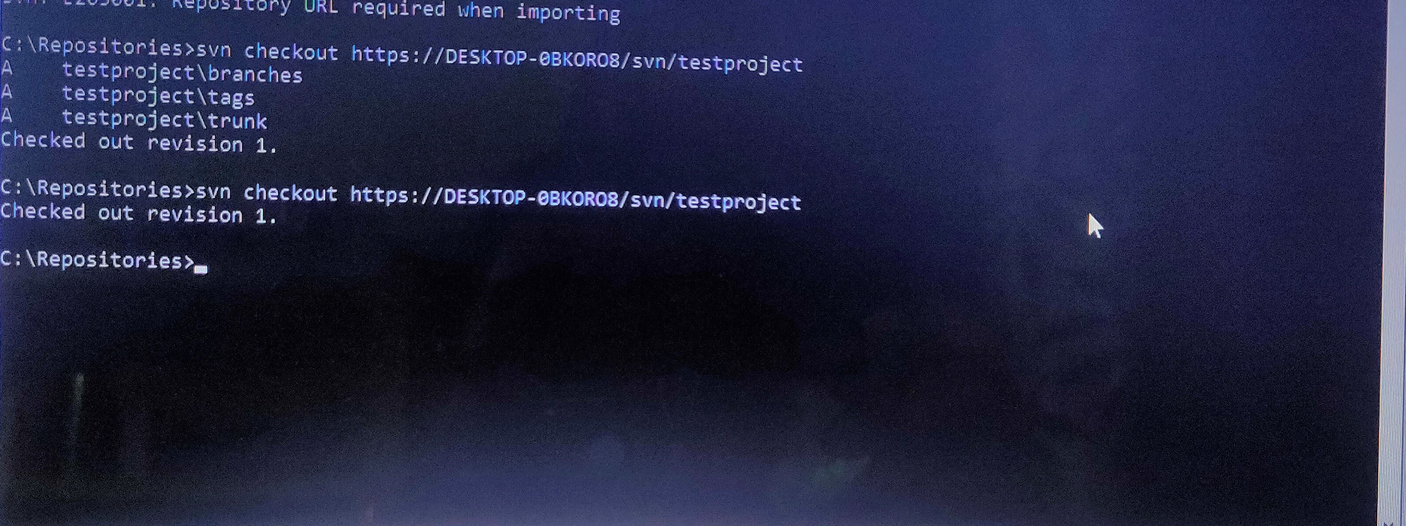
Then i imported 15 files into the repository testproject and for this we can use the svn import command, it commits an unversioned tree of files into a repository.
After that we have to checks out the working copy from the repository, for that I use svn checkout/co URL PATH.
If we want to access files from the SVN server, checkout is the first operation and then from where we can do edit, delete, or add contents.
We can also use svn client for doing these operations,for example here I am importing files using tortoise svn client and checkout using command.

Slide 17
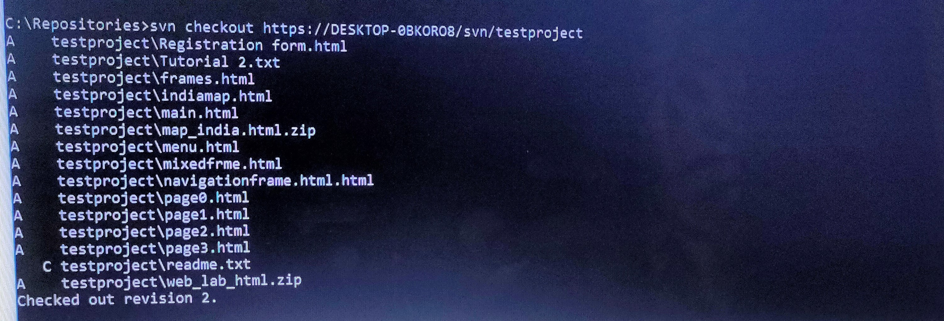
Then i use svn commit command to reflect those changes like importing done in working copy to the svn server,After committing I again checksout the repo,then I can see all those added files.

Slide 18
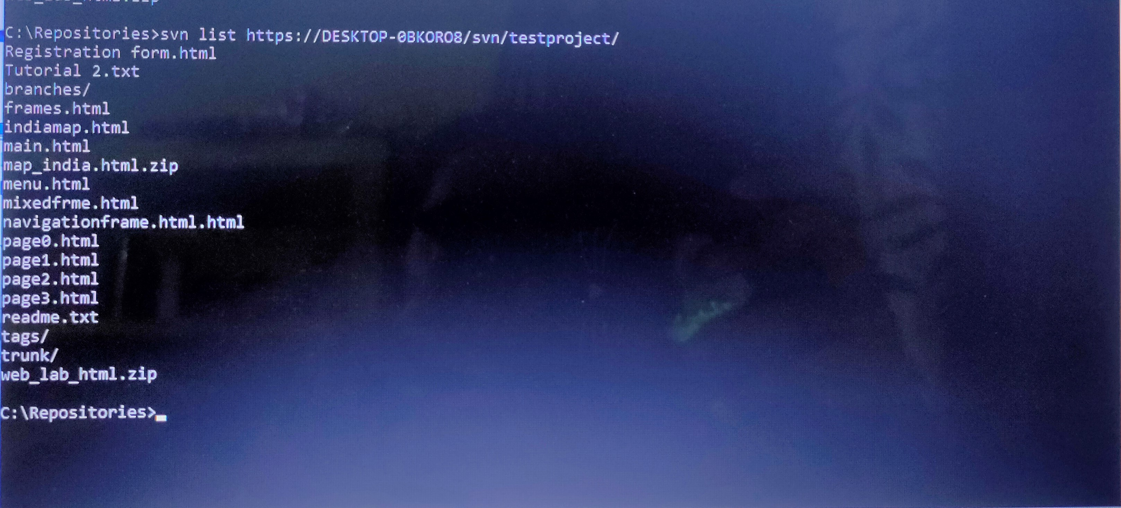
THERE ARE MANY COMMANDS IN SVN TO VARIOUS OPERATION IN CENTRALISED VERION CONTROL SYSTEM.
svn list command: This command is used to view the content of the SVN repository, without downloading a working copy.

Slide 19
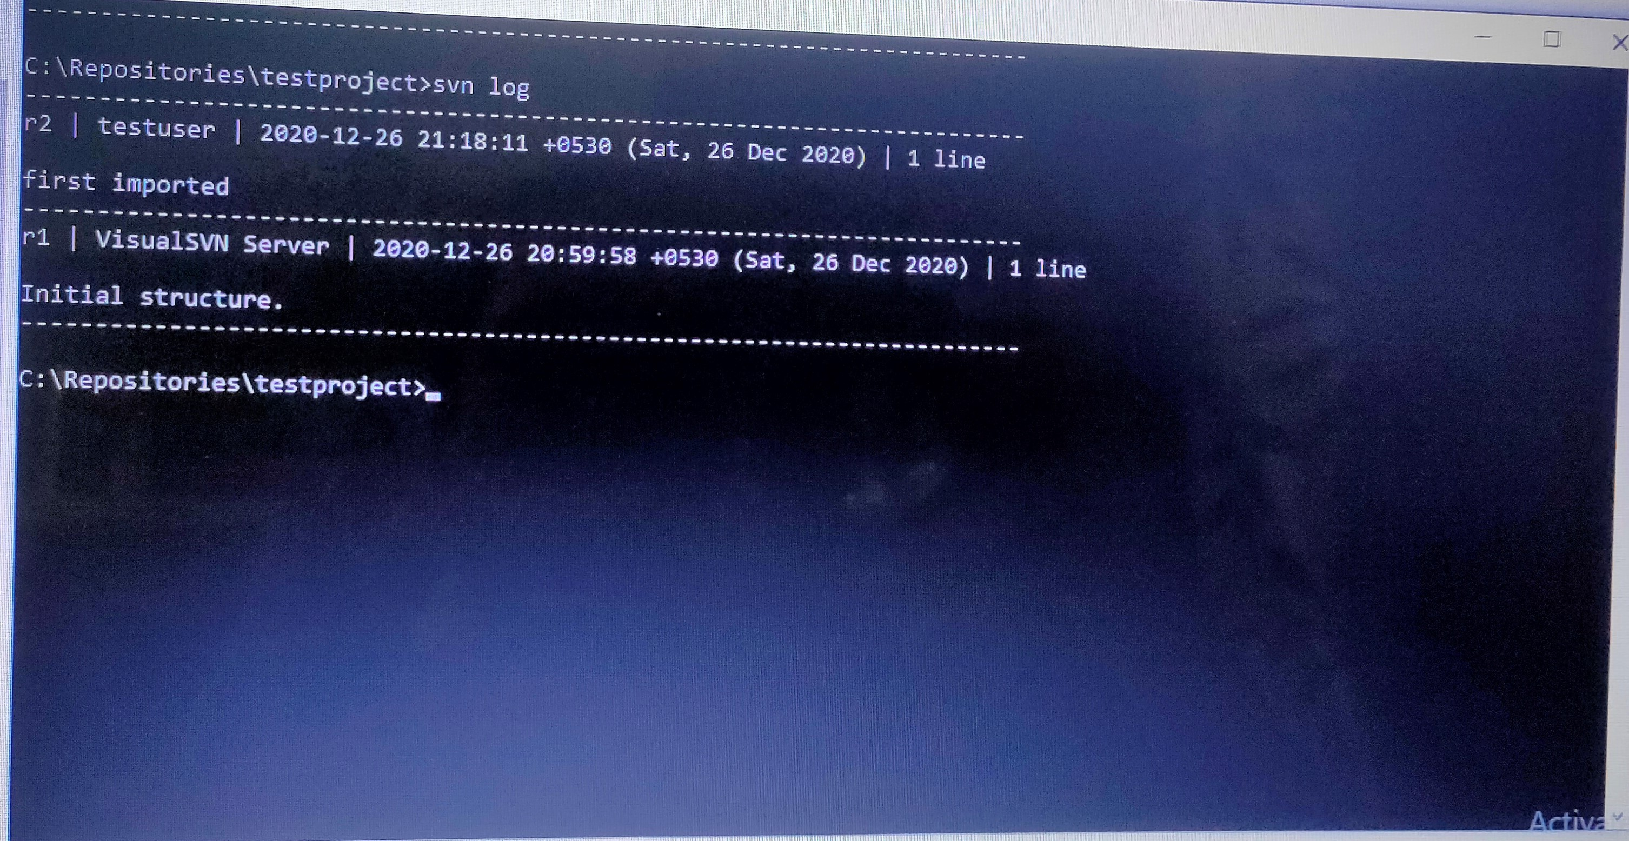
svn log command:This is used to know all the commits made in a file or directory

Slide 20
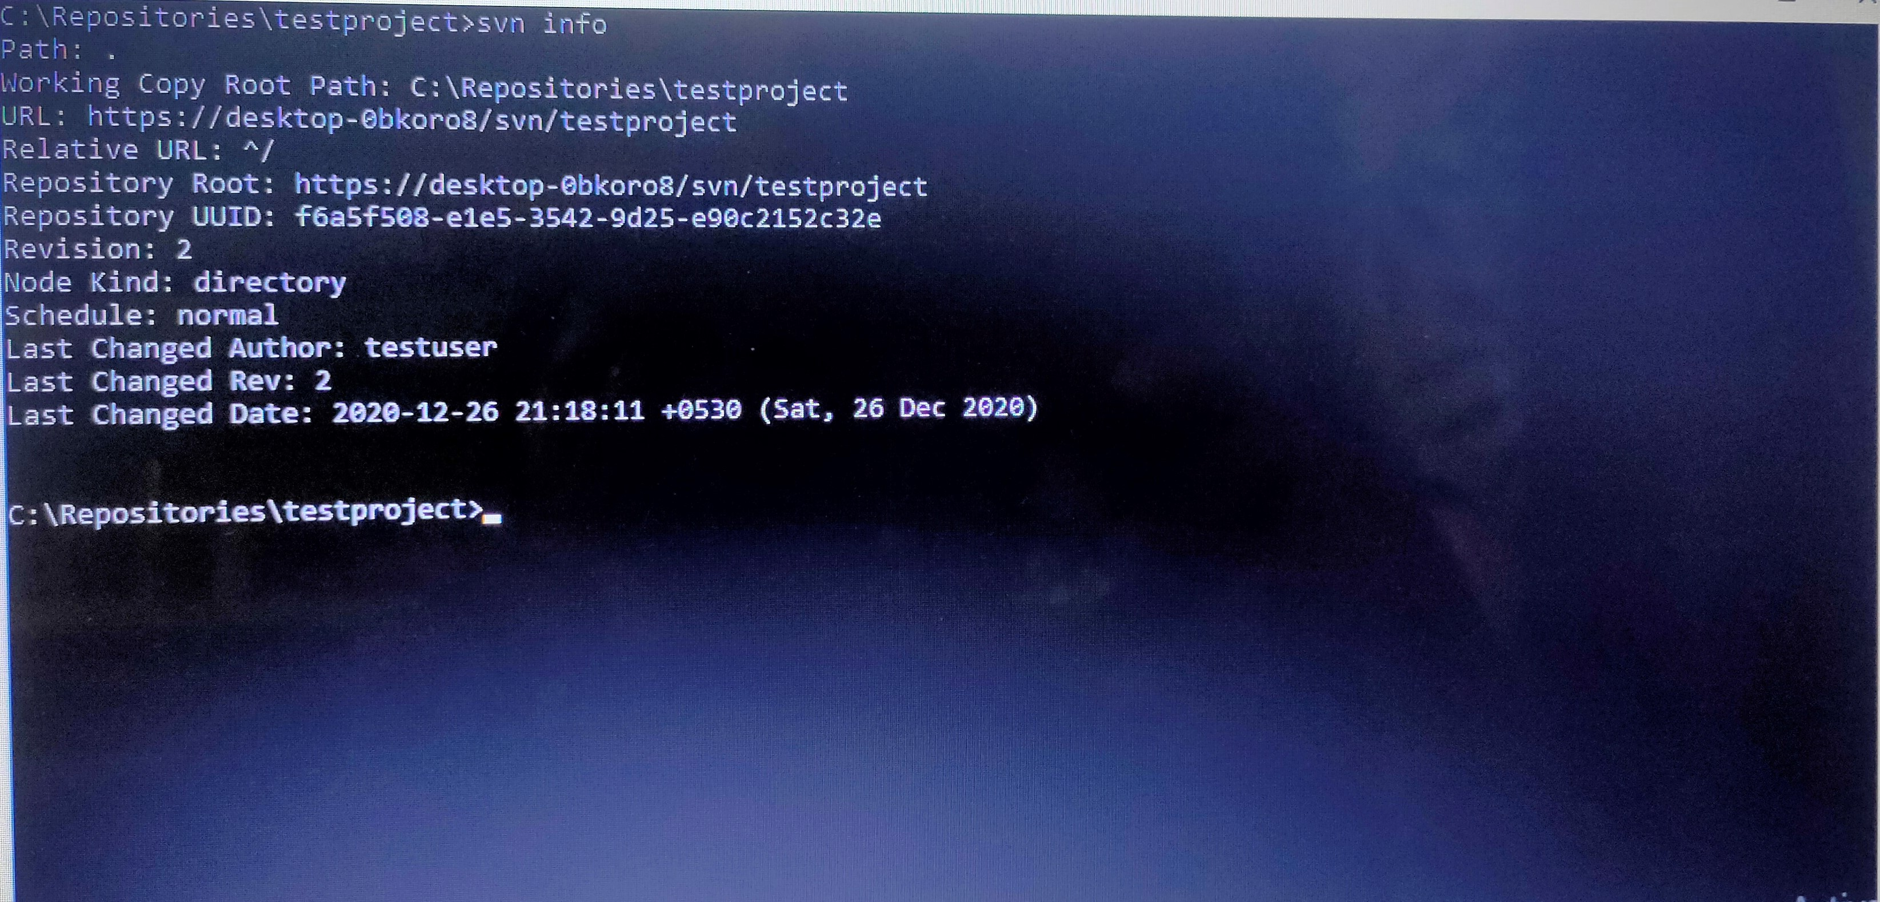
svn info command: This command gives information about the working copy paths or urls specified.

Slide 21
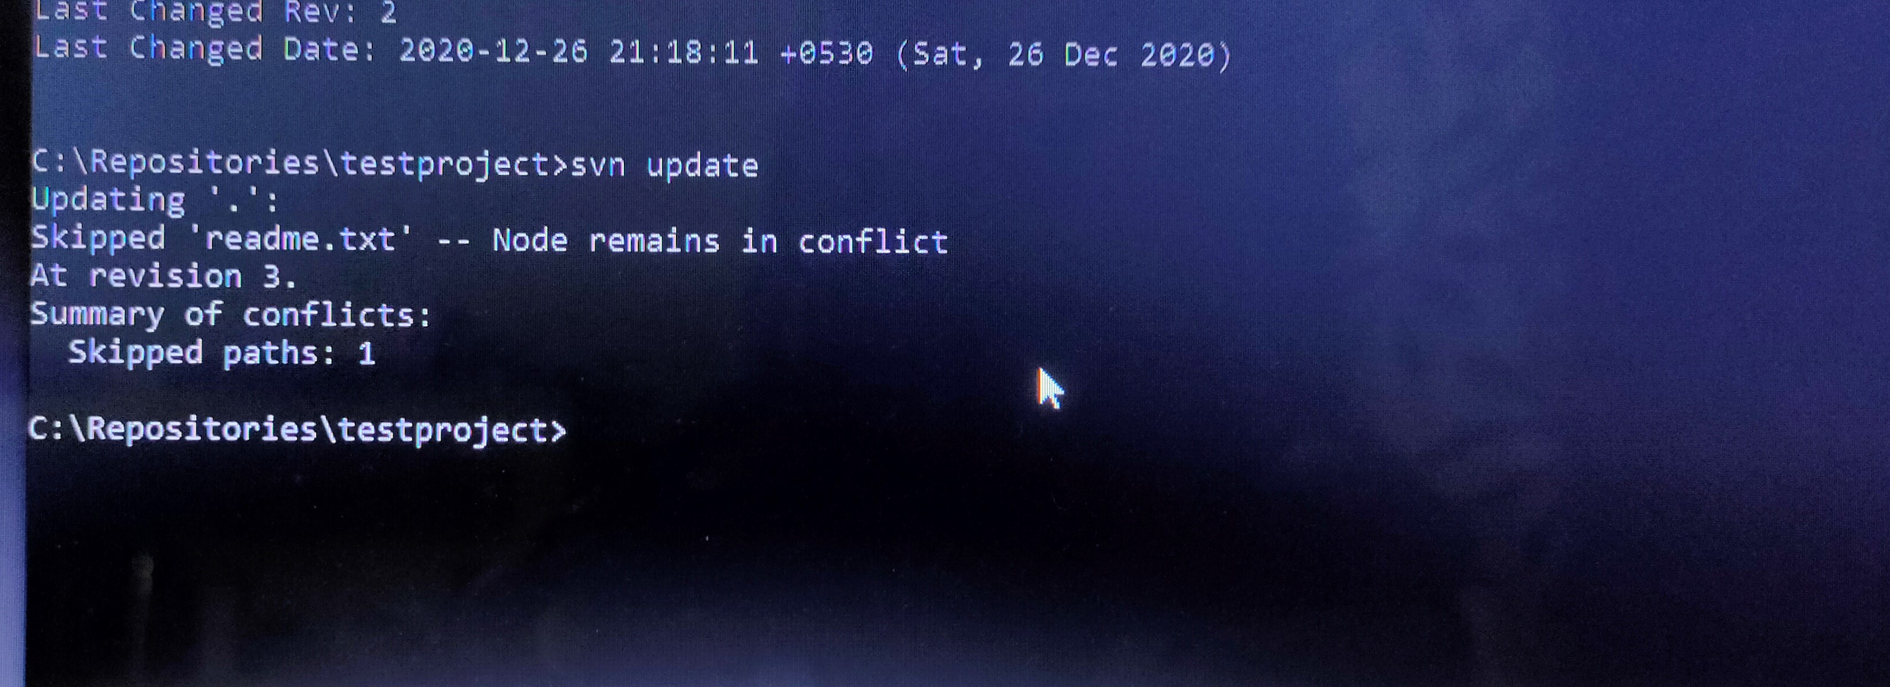
svn update command: This command brings changes from the repository into your working copy.

Slide 22
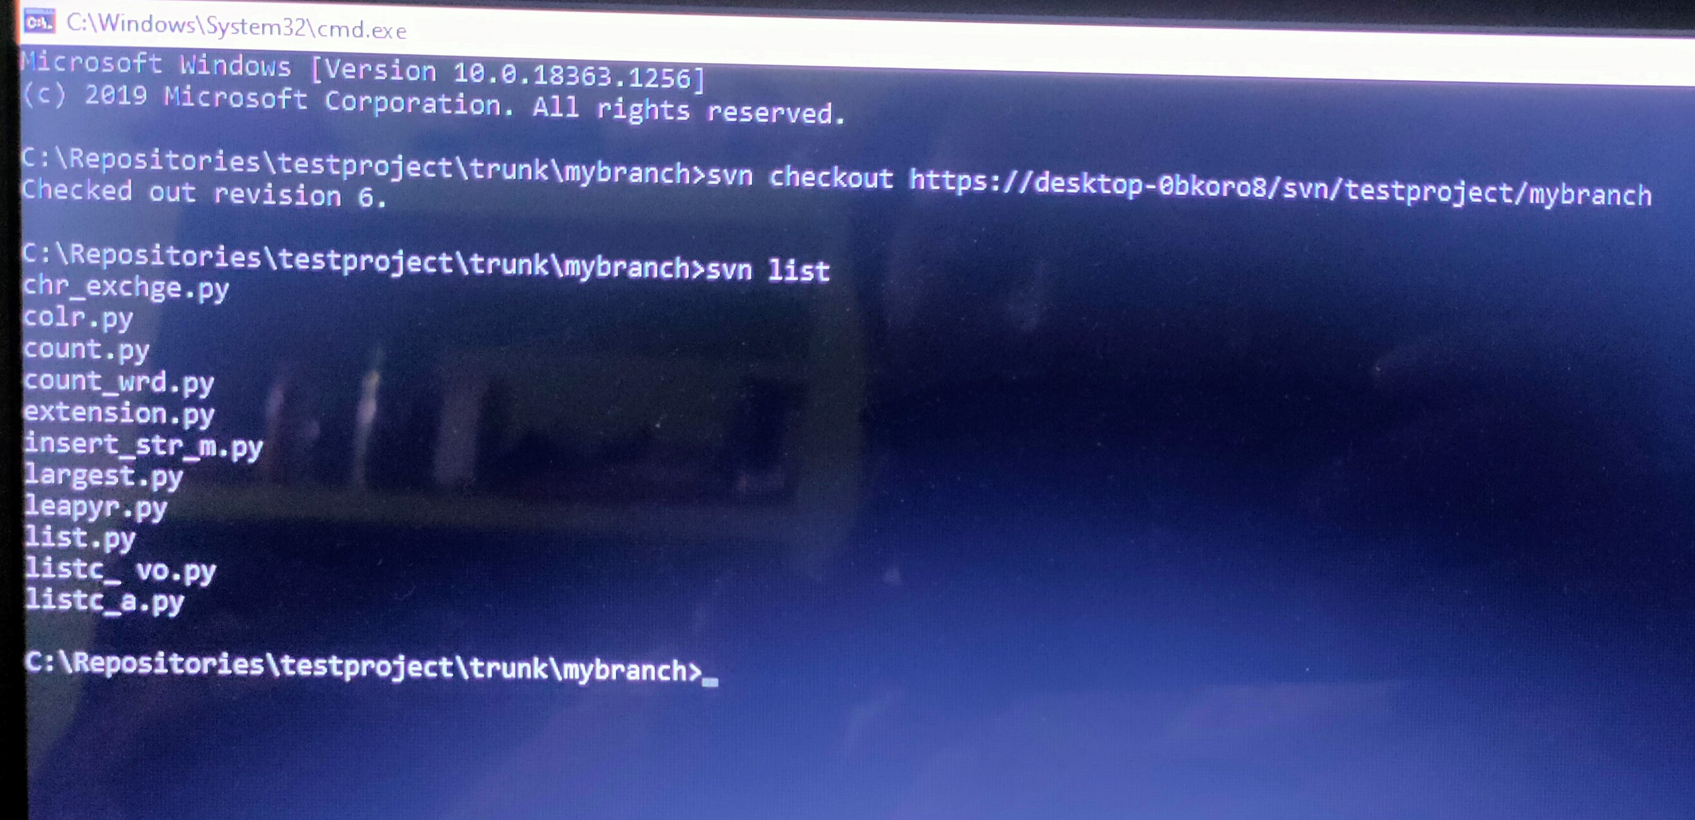
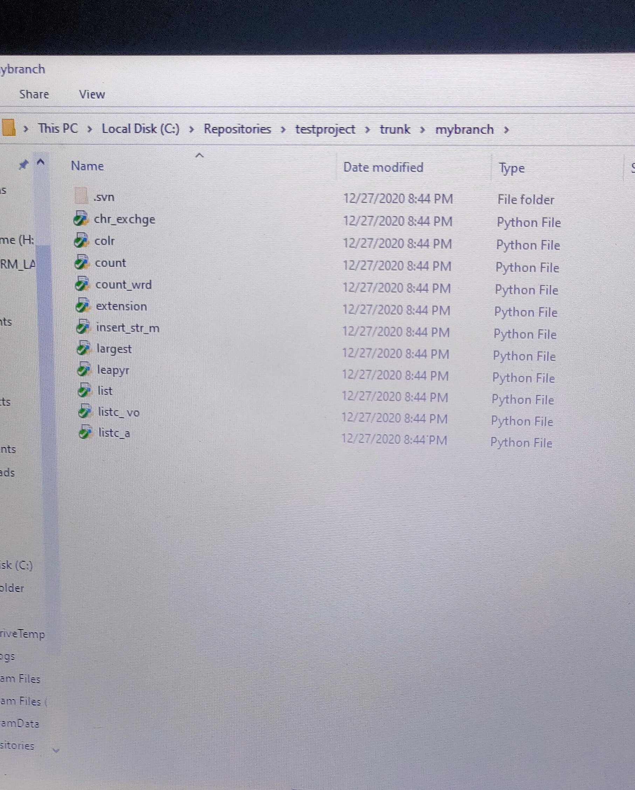
Creating a branch
I created a branch named “ mybranch” and to that branch I copied some files in repository using svn copy command

Slide 23
Git VS SVN
Like these commands svn contains several other commands like svn diff, svn merge, svn status, etc.
Also some commands in svn are also similar to git commands and some are different.
But the workflow behind these two version control systems are entirely different.
In git it is installed in our local workstation and it acts like both server and client , but in case of svn there is a separate server and client.
In git there is no need to download all files or versions all the time,but it is opposite in case of svn
That means in svn user always need to checkout and commit changes back to the server and for all these operations constant internet connectivity is necessary.
And in case of branching in svn, branches are created as directories inside a repository but git branches are only references to certain commits.

Slide 24
Git vs svn commands
Some of the important commands using in git and svn are as follows:
operation | svn commands | Git commands
Creates new repo | svnadmin create | git init
Copy files into local workplace | svn checkout <URL> | git clone or git fetch
Send back changes to remote repo or main project version | svn commit | git commit
Add a new file to repo | svn import | git add
Compares changes in files | svn diff | git diff

Slide 25
conclusion
After studying and using centralised version control and distributed version control systems , I noticed that both system have unique advantages and disadvantages.That means in storing large binary files and checking out faster is more flexible in case of centralised version control system. Compared to distributed vc like git ,svn is easier to learn.And at the same time git is better than SVN at branching and it can be better than SVN based on our needs.The main thing or the basic workflow behind the centralised vc like svn is that we have to maintain a working copy of the major project or the code of our project maintained in the server or master repo.And unlike git,this is a server-client model and the server is the main system that keep track all the versions, if we or clients or users want to work on any project, firstly user or client needs to get the code from the server. So the client communicates with the server and we need to take an update from the master repository and then we get the local copy of the code in our system. So once we get the latest version of the code, we can start making changes in the code and after that, we simply need to commit those changes straight forward into the master repository. Then the changes will gets reflected int the master repo.

Slide 26
references
https://subversion.apache.org/docs/
http://svnbook.red-bean.com/
https://tortoisesvn.net/docs/release/tortoisesvn_en/index.html

